Slide 1
GLO POC ON-DEMAND REPORT
April, 2020
By Jacinta Ejiofor

Slide 2
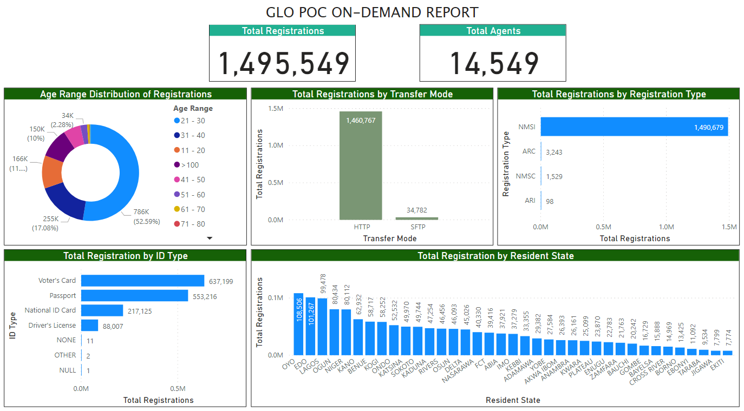

Slide 3
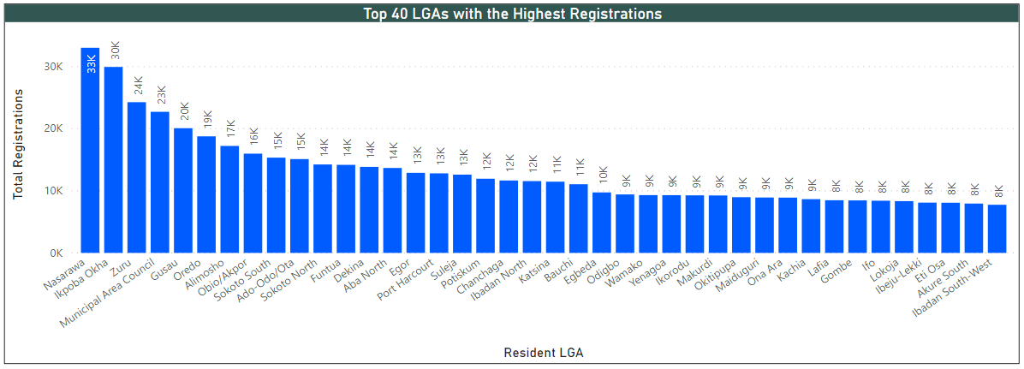

Slide 4
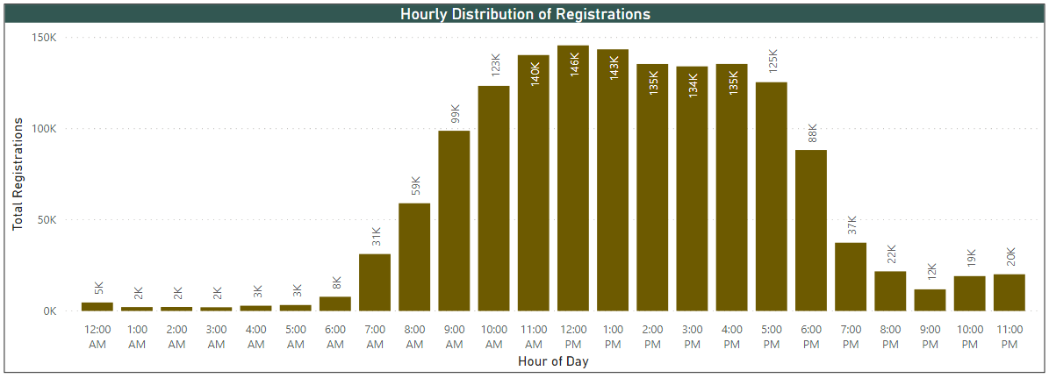

Slide 5
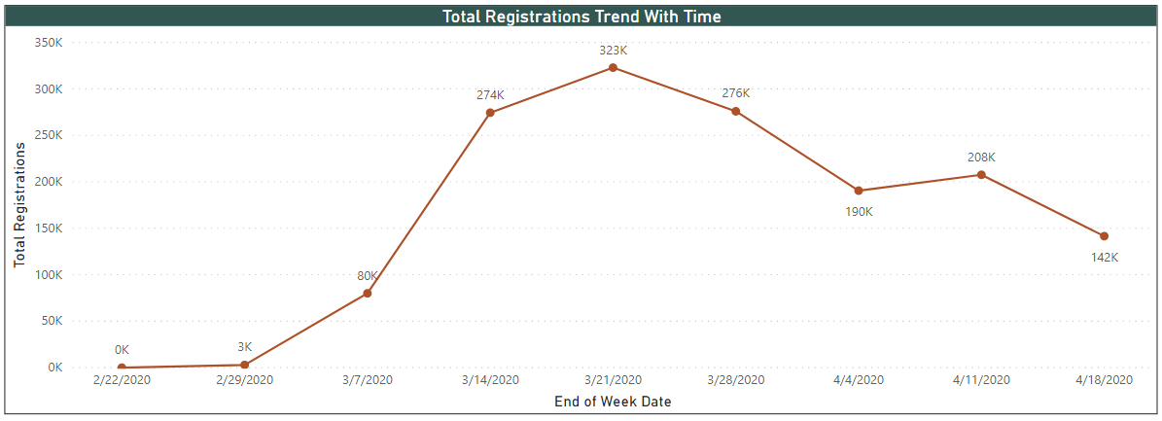

Slide 6
KEY METRICS (FROM INCEPTION – 17/04/2020)
METRIC | EXPLANATION | AVERAGE VALUE
Capture2Sync Time | Time it takes for SIM registration to move from client device to the SFTP Server/Sync Processor server | 14 days, 6 hours, 48mins & 36 seconds
Capture2Mcentric | Time it takes for SIM registration to move from a client device to the SFTP Server, be processed into the database and then pushed to the MCentric server | 14 days, 11 hours, 1 minute & 45 seconds
Sync2Backend | Time it takes for BFP or Sync Processor to process a registration from the SFTP server into the database | 27mins & 24 seconds

Slide 7
KEY METRICS FOR LAST WEEK ALONE (13/04/2020– 17/04/2020)
METRIC | EXPLANATION | AVERAGE VALUE
Capture2Sync Time | Time it takes for a SIM registration to move from client device to the SFTP Server/Sync Processor server | 16 days, 17hours, 10 minutes & 32 seconds
Capture2Mcentric | Time it takes for SIM registration to move from a client device to the SFTP Server, be processed into the database and then pushed to the MCentric server | 16 days, 17 hours, 16 minutes & 23 seconds
Sync2Backend | Time it takes for BFP or Sync Processor to process a registration from the SFTP server into the database | 3 seconds

Slide 8
CoMMENTS
There are some registration dates in the DB that are very incorrect. We have registration dates that are as extreme as “2100-01-05 and “1979-12-31” and as a result, the average values for Capture2Sync Time and Capture2Mcentric Time are highly affected. This is beyond our control as these are the timestamps we receive from these clients.
I think for now, the most accurate of the three metrics that we can use to determine any form of efficiency is the Sync2Backend metric as it does not take into account any client time.

